Slide 1
Department of Information Communication Technology veer narmad South gujarat University, Surat
PROJECT TITLE: COOKING HUB
SUBMITTED BY:
CHODVADIYA NEEL S. [10021]
GUIDED BY:
DR. PUSHPAL DESAI

Slide 2
ACKNOWLEDGEMENT
When we reach the completion of the project giving Credit becomes a must, as without the support of other so many People's help and guidance this project could not be completed successfully.
We would like to thank Dr. Pushpal Desai for guiding us and sharing their thoughts and views on the project for framing the realistic picture of the requirement and involvement needed in this project. They were always there with their great ideas and suggestions whenever we needed. They took a great deal of interest in our work and encouraged us to out of perform our self. They believed in us and were a pillar of strength for us.
We would like to thank Dr. Dhaval Joshi to help us prepare this project. I would also appreciate their guidance and technical knowledge they gave me regarding this subject.
Last but not least, our heartfelt appreciation goes to all those not named Here, but who have rendered their cooperation, little or more, directly or indirectly. In the course of development of this System & Preparation of this document.
Thanking All.
Neel Chodvadiya

Slide 3
CONTENTS
Introduction
Project Profile
Project Overview
Environment description
Hardware & Software Requirement
Project Scope
UML Diagrams
Use Case Diagram
Activity Diagram
ER Diagram
System Design
Table Structure
Screen Layout
Future Scope

Slide 4
INTRODUCTION
PROJECT PROFILE:
Project Title | Cooking Hub
Project Definition | Cooking Hub is an online platform designed to provide a user-friendly and interactive space for individuals passionate about cooking and culinary arts. The platform aims to bring together cooking enthusiasts, enabling them to create and share recipes, like and review recipes, engage in blog discussions, and interact with fellow food lovers.
Organization | FameUX Technologies LLP
Project Type | MVC core web site
Development Tool | Visual Studio , SQL Server Management Studio (SSMS)
Platform | .Net core
Duration | 3 Months
Project Guide | Dr. Pushpal Desai Rahul Ladumor
Submitted By | Mr. Neel Chodvadiya

Slide 5
PROJECT OVERVIEW
The Cooking Hub is an innovative online platform designed to cater to cooking enthusiasts of all levels. It serves as a one-stop destination for individuals passionate about exploring recipes, sharing experiences, and connecting with like-minded individuals. This proposed system aims to provide users with a seamless experience to discover, interact, and engage with a variety of culinary content. Let's explore the key features of the Cooking Hub:
Recipe Exploration:
Users can browse through an extensive collection of recipes from various cuisines, dietary preferences, and skill levels. The platform offers a user-friendly interface to search, filter, and sort recipes based on specific criteria. Each recipe page provides detailed instructions, ingredients, and user-generated ratings and reviews.
Recipe Liking and Reviewing:
Users can express their appreciation for recipes they find appealing by "liking" them, thus providing feedback to the recipe creators. Additionally, users can leave reviews, sharing their personal experiences, modifications, or suggestions related to a particular recipe. This promotes interaction and community engagement within the platform.
Blogging and Commenting:
The Cooking Hub allows users to create and share their cooking-related blogs, documenting their culinary journeys, tips, tricks, and unique recipes. Users can engage in discussions by commenting on blogs, fostering a sense of community and knowledge exchange among cooking enthusiasts

Slide 6
HARDWARE & SOFTWARE REQUIREMENTS
CLIENT SIDE:-
• Operating System: Any.
• Web Browser: Internet Explorer, Opera, Firefox, Google Chrome
Server side :
• Operating System: Any.
• Development: visual studio 2019 or above
• Database: MySQL Server Management Studio
Development Side :
• Processor : Intel Core i5
• Memory : 8.00 GB
• Hard disk : 500gb
• Web Browser : Google Chrome (Recommended)

Slide 7
FEATURES AND FUNCTIONALITY
GUEST:
Can see all the Blogs
You can visit any Recipes
You Can register itself
You Can see user details
You Can see reviews of the posts.
USER:
Can login
View post
Comment on post
Like the Blogs
Can create a recipe
Can Like Recipe
Comment the blog
Review the recipes

Slide 8
ADMIN:
Manage User Accounts
Recipe Moderation
Blog Moderation
Manage Awards
Mange Cuisine

Slide 9
UML DIAGRAMS

Slide 10
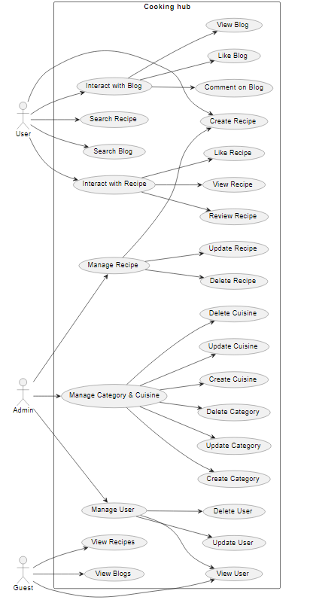
USECASE DIAGRAM

Slide 11
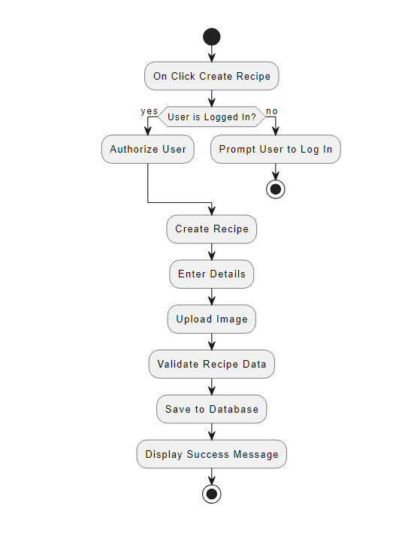
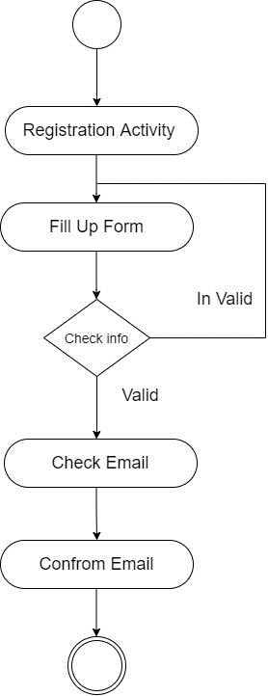
ACTIVITY DIAGRAM
❖ Activity Diagram of Registration :
❖ Activity Diagram of Create Post :

Slide 12
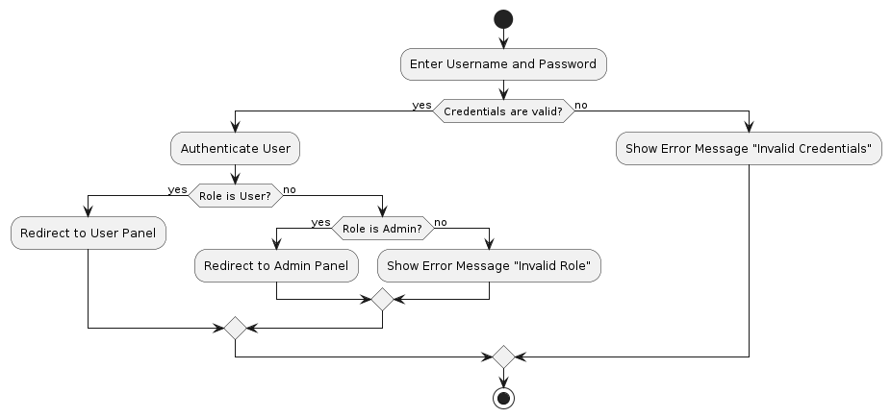
❖  Activity Diagram of Login :

Slide 13
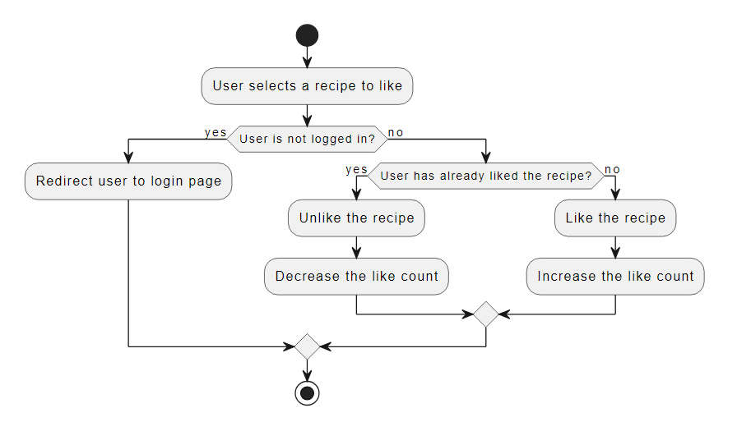
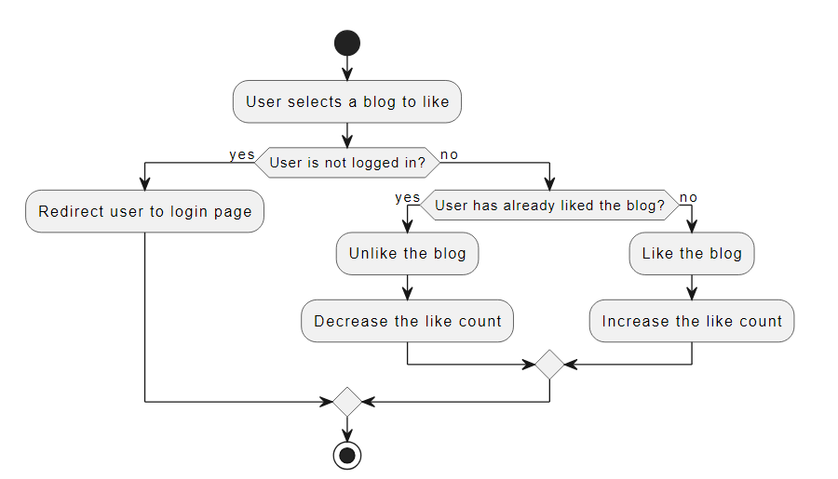
❖ Activity Diagram of Recipe and Blog Like :

Slide 14
Table Structure
AspNetRoles Table
Fields | Type | Constraint | A_I
Id | nvarchar(450) | Primary Key
Name | Nvarchar(50)
NormalizedName | Nvarchar(50)
ConcurrencyStamp | Nvarchar(Max)
AspNetUserRoles
Fields | Type | Constraint | A_I
UserId | nvarchar(450) | Primary Key
RoleId | nvarchar(450) | Foreign Key
AspNetUserTokens
Fields | Type | Constraint | A_I
UserId | nvarchar(450) | Primary Key , Foreign Key
LoginProvider | nvarchar(450)
Name | nvarchar(450)
Value | nvarchar(MAX)

Slide 15
AspNetUsers Table
Recipe
Fields | Type | Constraint | A_I
Id | nvarchar(450) | Primary Key
UserName | nvarchar(256)
Email | nvarchar(256)
PasswordHash | nvarchar(256)
SecurityStamp | nvarchar(MAX)
ConcurrencyStamp | nvarchar(MAX)
PhoneNumber | nvarchar(MAX)
Gender | nvarchar(MAX)
ImageFilePath | nvarchar(MAX)
IsActive | bit
CreatedAt | datetime2(7)
FirstName | nvarchar(MAX)
LastName | nvarchar(MAX)
Fields | Type | Constraints | A_I
RecipeId | nvarchar(450) | Primary Key
UserId | nvarchar(450) | Foreign Key
CategoryId | nvarchar(450) | Foreign Key
RecipeTitle | varchar(255)
CuisineId | nvarchar(450) | Foreign Key
RecipeshortDescription | text
RecipeDescription | text
PreparationTime | time(7)
CookingTime | time(7)
Serving | int
Views | int
Ingridients | nvarchar(MAX)
Nutrition | nvarchar(MAX)
RecipeImage | nvarchar(MAX)
IsActive | bit
CreatedAt | datetime
UpdatedAt | datetime

Slide 16
Blog
Fields | Type | Constraint | A_I
BlogId | nvarchar(450) | Primary Key
CategoryId | nvarchar(450) | Foreign Key
UserId | nvarchar(450) | Foreign Key
BlogTitle | varchar(255)
BlogshortDescription | text
BlogContents | text
BlogImage | nvarchar(MAX)
BlogIsActive | bit
CreatedAt | datetime
UpdatedAt | datetime
Category
Fields | Type | Constraint | A_I
CategoryId | nvarchar(450) | Primary
CategoryName | varchar(50)
CategoryIsActive | bit
CategoryImage | nvarchar(MAX)

Slide 17
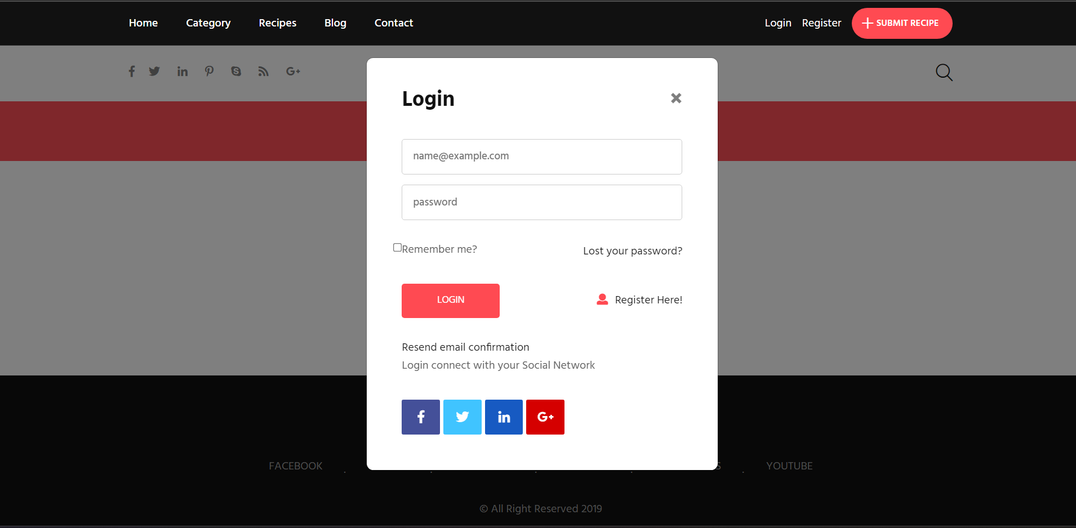
Screen Layout
Login page

Slide 18
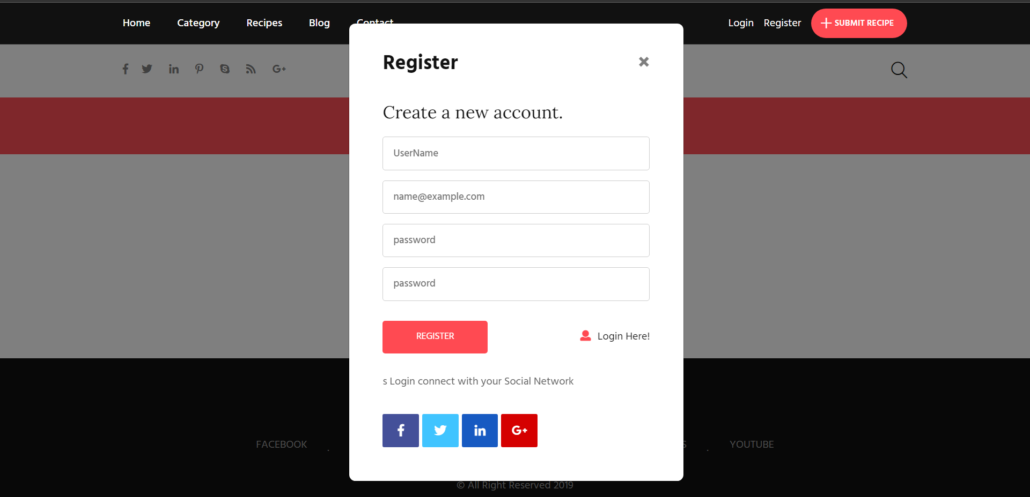
Registration page

Slide 19
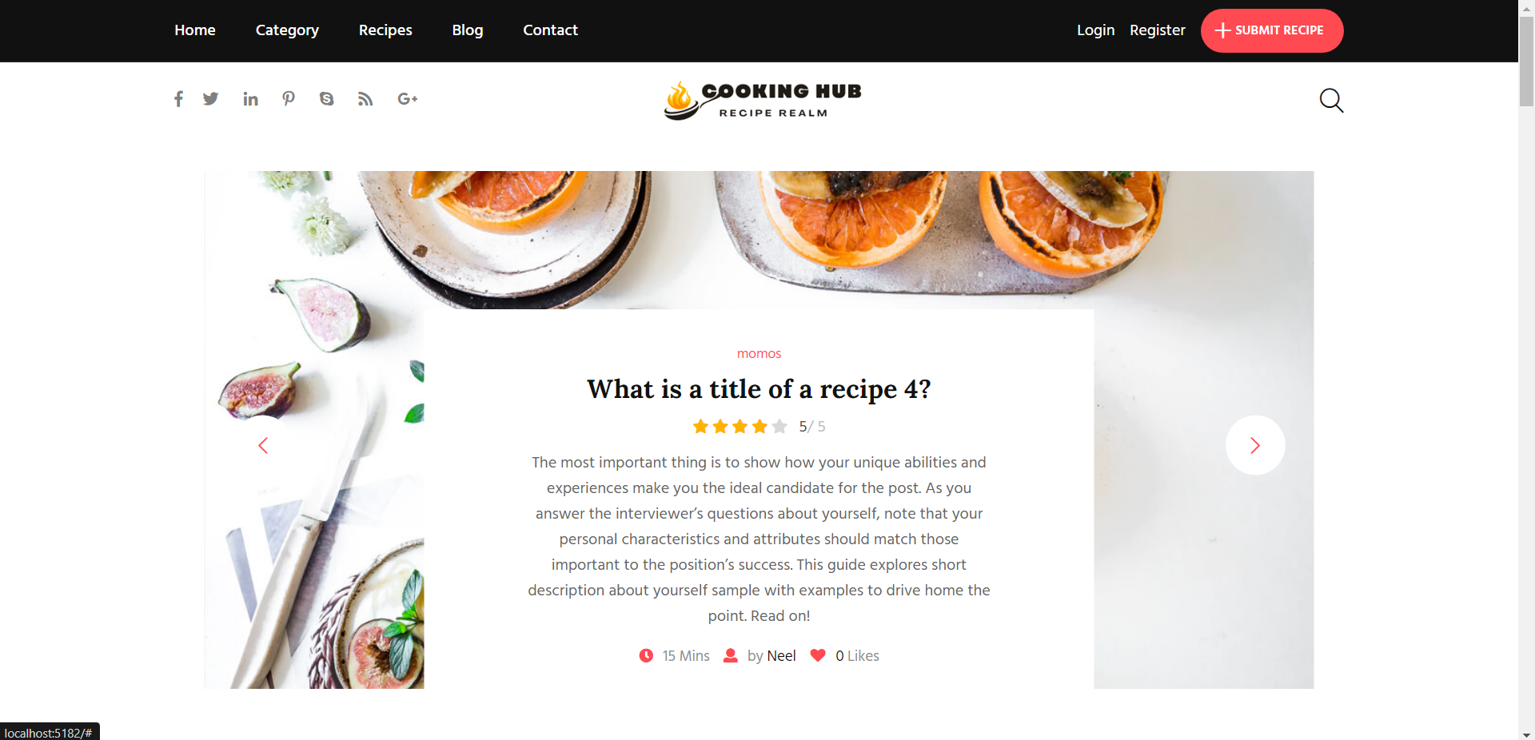
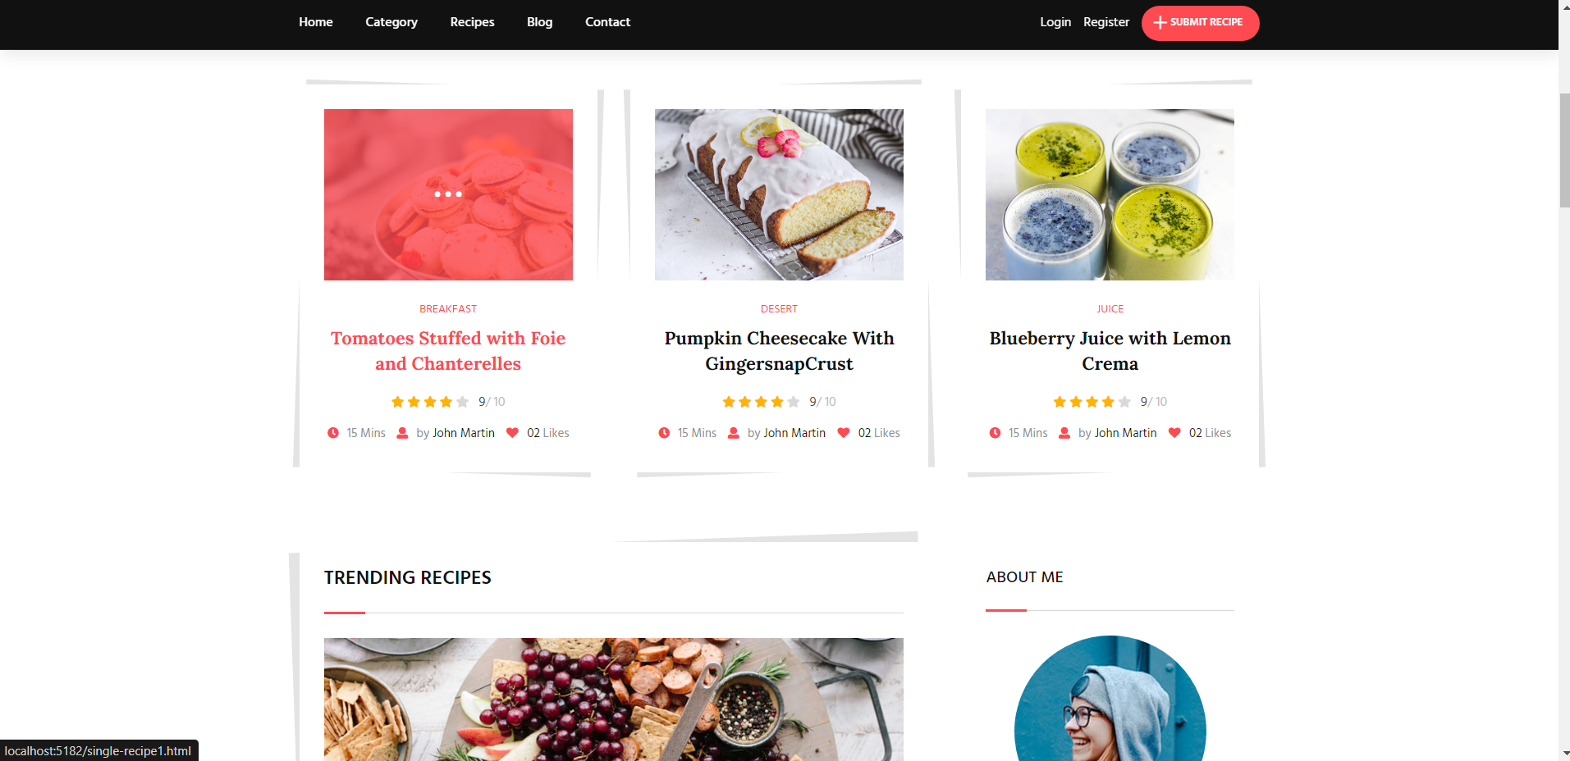
Home Page

Slide 20
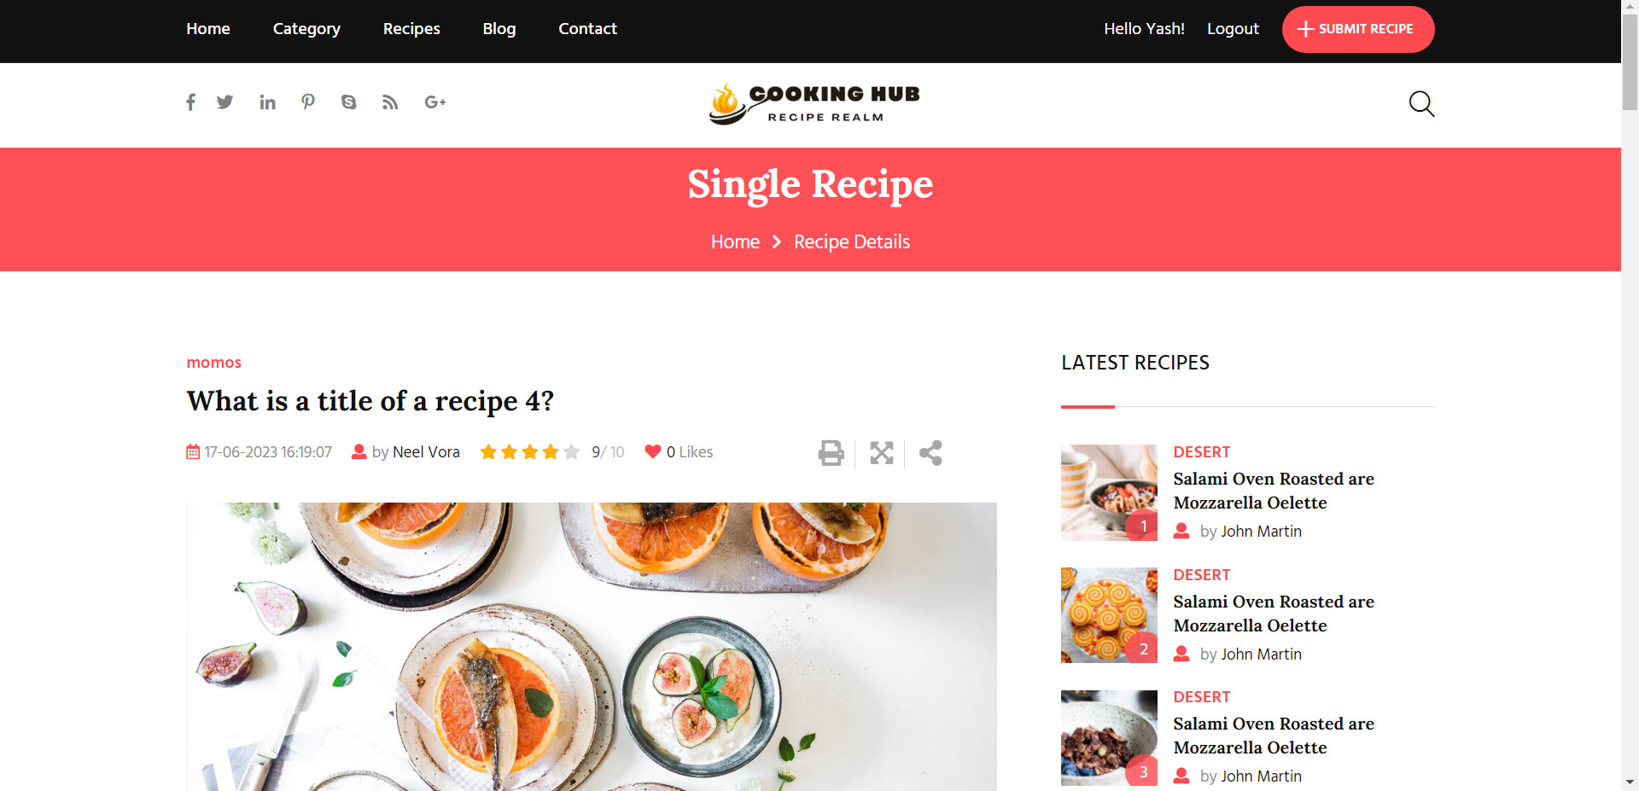
Recipe Detail page

Slide 21
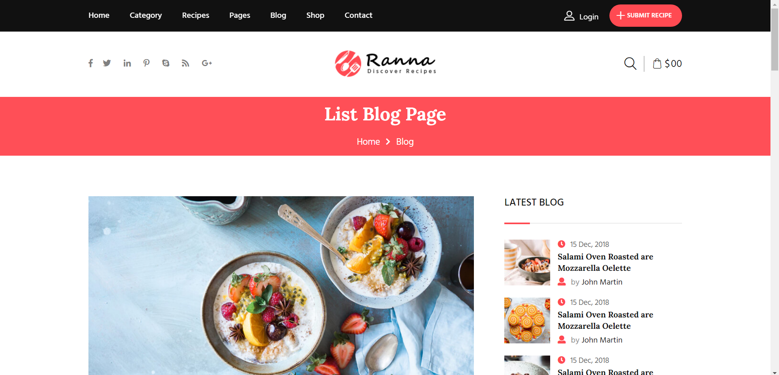
Blog List Page

Slide 22
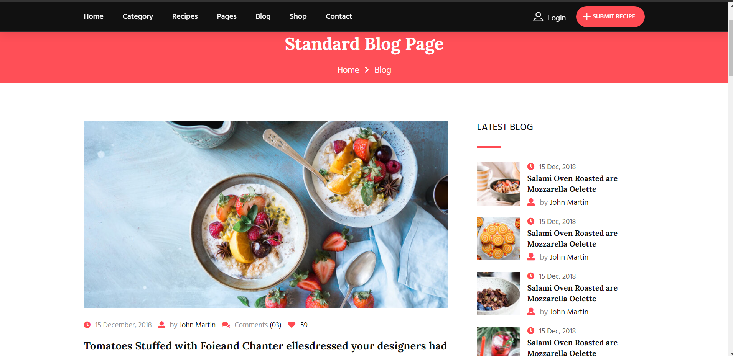
Blog View Page

Slide 23
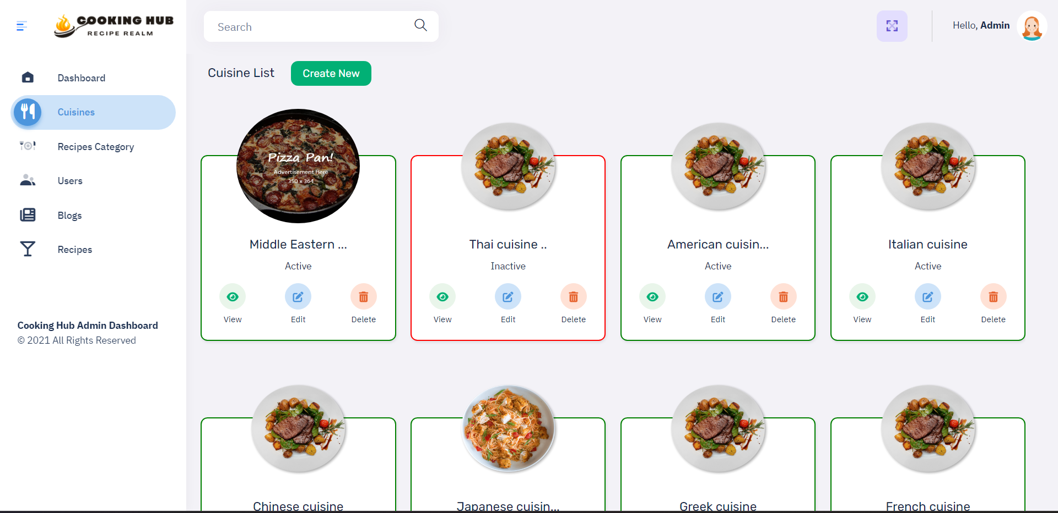
Admin

Slide 24
FUTURE SCOPE AND ENHANCEMENTS
Advanced Search Functionality: Implement an advanced search feature that allows users to search for recipes based on various criteria such as ingredients, dietary restrictions, cooking time, cuisine, and more. This can help users find specif recipes more easily.
Personalized Recipe Recommendations: Develop a recommendation system that suggests recipes to users based on their past cooking preferences, liked recipes, and dietary restrictions. This feature can enhance the user experience by providing personalized content.
Meal Planning and Grocery List: Enable users to plan their meals by creating weekly or monthly meal plans within the cooking hub. Additionally, allow users to generate a grocery list based on their selected recipes, making it more convenient for them to shop for ingredients.

Slide 25
REFERENCES
https://www.simplyrecipes.com/
https://www.epicurious.com/
https://www.foodnetwork.com/
https://www.allrecipes.com/

Slide 26
THANK YOU VERY MUCH

